Slide 1
Common Defects for C/C++
Code: N/A
Authors: BaoTD1
Course: <Course-Name>
Conductor: <Acc> – <Unit>

Slide 2
Objectives
The course helps attendees understand:
Common defects for C/C++ and how to prevent it.

Slide 3
Contents
Common Defect For C/C++
Examples

Slide 4
Common Defects for For C/C++
Coding Standard
Hard Code
Logic
Performance

Slide 5
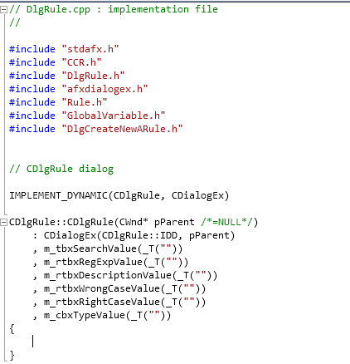
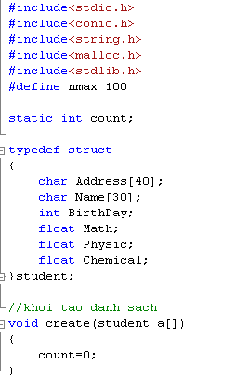
Coding Standard
Not follow coding rule

Slide 6
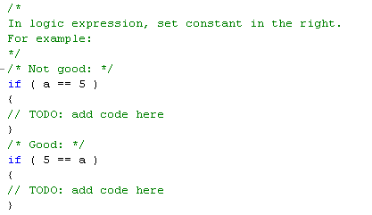
Coding Standard(cont)
Not understanding coding convention of C.

Slide 7
Coding Standard(cont)
Not check NULL

Slide 8
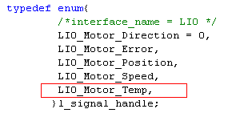
Coding Standard(cont)
Did not remove comma after last element of ENUM

Slide 9
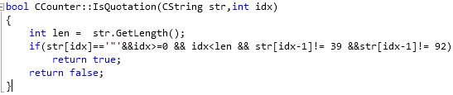
Coding Standard(cont)
Hard to read the code

Slide 10
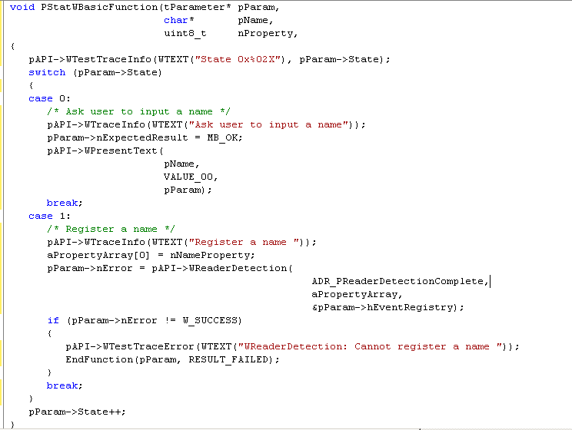
Coding Standard(cont)
Missing default in switch statement

Slide 11
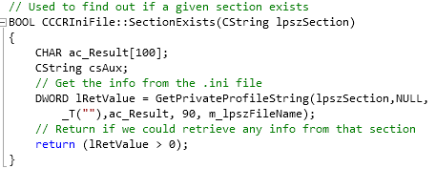
Hard Code
Use Hard code

Slide 12
Logic
Các biến count trong các vòng lặp lồng nhau thì cần phải để là I, j, k
Free memory of a pointer
int *p = new int[256];
….
delete p; /* Wrong */

Slide 13
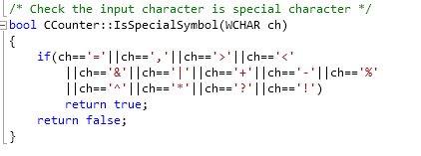
Logic(cont)
technique skill chưa tốt

Slide 14
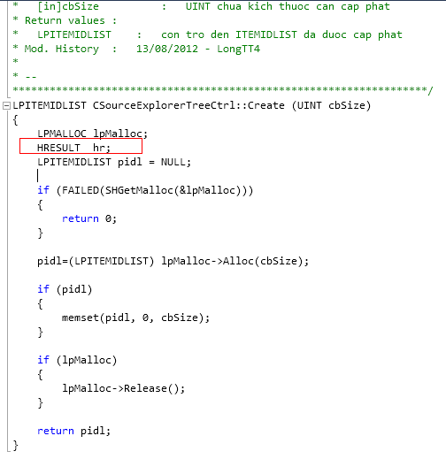
Performance
Variables are declared but it is not used

Slide 15
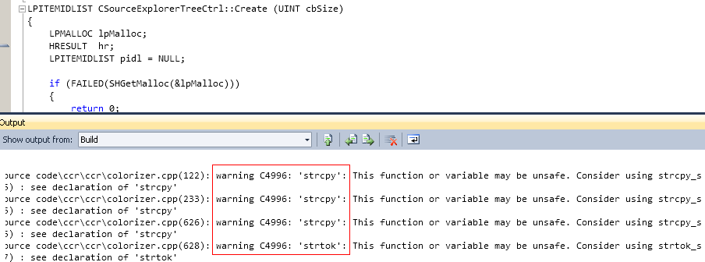
Performance(cont)
Warning is still remaining when source code is compiled.

Slide 16
Q & A

